Slide 1
Predicting Pittsburgh Single Family Home Prices
Cole Thomas (nhthomas)
Sai Rajuladevi (srajulad)
Kraig Sheetz (ksheetz)
Hannah Fairfield (hfairfie)

Slide 2




Team of aspiring data scientists and product managers
Cole Thomas
LinkedIn Profile
MISM-BIDA (22)
Kraig Sheetz
LinkedIn Profile
MISM-BIDA (23)
Sai Rajuladevi
LinkedIn Profile
MISM-BIDA (22)
Hannah Fairfield
LinkedIn Profile
MISM-BIDA (23)

Slide 3
Problem Statement
Given current real estate market difficulties, use non-conventional data to predict home prices
Input -> Output
Criteria for Success
Notes:
With today’s hot real estate market, it is more difficult than ever to find value in a home purchase. Our product leverages non-conventional data streams to better predict the actual selling price of homes. This allows real estate investors to identify properties that are potentially undervalued relative to the market, and find value where other investors may not think to look.
For our input, we are looking at basic information about a house, expanding off of the basic features that Redfin looks at to include crime, local school information and census information, to predict a home selling price which is our output. In order to say our model is successful, we want to see an increase in performance metrics and predictive power between the base Redfin model and our model.

Slide 4






External Data Sources
Home Data
Crime Stats
School Stats
Combined Dataset
ACS Survey
Notes:
Kraig
If you are using external data sources ->
Where does the data come from?
What does it look like (size fields type)?
What does your exploratory data analysis reveal about how the data should be prepared and used?

Slide 5

Features
Redfin
Notes:
Summarize your approach -> what learning methods or other algorithms are you using? →

Slide 6
Redfin Dataset Description
1989 x 29
Categorical:
Nominal: 13
Ordinal: 2
Numerical:
Discrete: 4
Continuous: 10
Notes:
Explore baseline model features
So, starting with the redfin dataset, we pulled just single-family homes, which left us with a little bit less than 2000 data points, and 29 features.

Slide 7
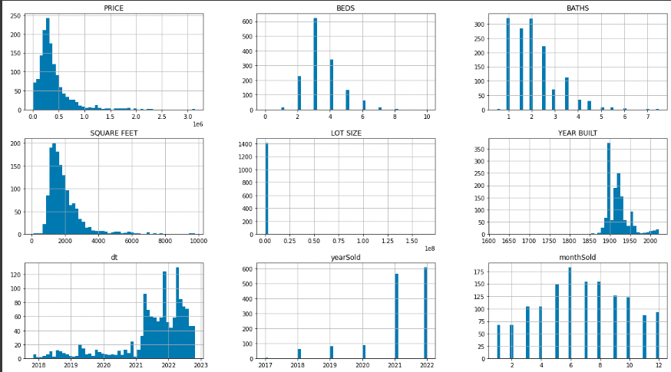
Redfin Dataset Features
Notes:
When looking at the features we see that some of them are skewed and the features all have different magnitudes which we will need to address
When building more advance models outside of our baseline
Our target value, located in the top left, is PRICE, and it has a median of $295K
Other features like # of bedrooms and # of bathrooms are also included in this data. Through this and exploring the dataset we can see if we need to drop outliers.
Explore baseline model features
Printing the minimums, maximums, and averages is helpful to see if we have any surprising outliers, or potential typos entered into the system. The first one to notice is that the oldest house was built in 1620. We expect that to be a typo. Nothing else was very shocking to us though.

Slide 8
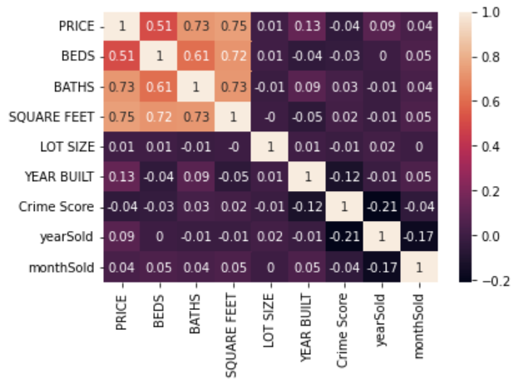
Redfin Data Exploration
Notes:
We also ran a correlation matrix to check for collinearity to make sure we don’t have any unreliable predictors. The highest is between square feet and price, but at .75 is not high enough to omit the variable.

Slide 9
Baseline Model

Slide 10
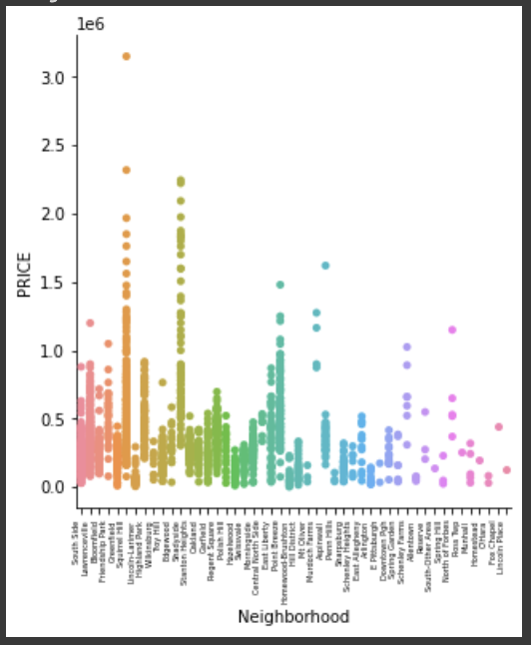
Baseline Model – Features
A
Beds | Price | Year Sold
Square Feet | Bath | Month Sold
Neighborhood | Lot Size | One-Hot Encode Neighborhood
Location | Year Built
B
C
1989 x 55
Squirrel Hill
Shadyside
Point Breeze
A
B
C
Notes:
Explore baseline model features
Our baseline model is solely the Redin dataset.
After one hot encoding the neighborhoods, we see that Squirrel Hill, Shadyside, Point Breeze, have both higher maximums and larger price distributions than other neighborhoods.
Now looking at the top left of the slide, we see the standard features that we will use in our baseline model.

Slide 11
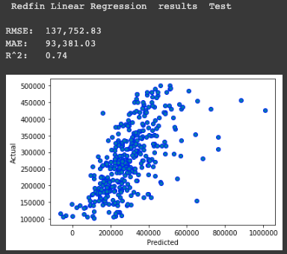
Baseline Model – Preliminary Results
Linear Regression
Split 75% train (1491) 25% test (498)
Notes:
We ran a linear regression model, splitting our training and testing into 75% train and 25% test. The RMSE and MAE are in dollars representing the price of a house
Through additional feature engineering and more advanced modeling techniques we hope to improve upon the baseline model

Slide 12

The Approach – Search for New Features
Redfin
Local schools
Notes:
Summarize your approach -> what learning methods or other algorithms are you using? →

Slide 13
New Features - Local Schools
Notes:
Next we can look at information derived from the NCES -
—----------------------------------------------------
Used the National Center for Education Statistics (NCES) data portal to pull all available data on Pittsburgh Public Schools
For each home, we assigned it two school quality scores: one for the nearest High School, and one for the nearest Elementary/Middle School
Used performance data for schools to calculate a “School Quality” Score:
For High Schools, this was an average of the 4 and 5 year cohort graduation rate, as well as the post-secondary education graduation rate
For Elementary and Middle Schools, this was an average of the percentage of students within the school who were meeting annual growth expectations for ELA/Literature, Mathematics, and Science/Biology

Slide 14
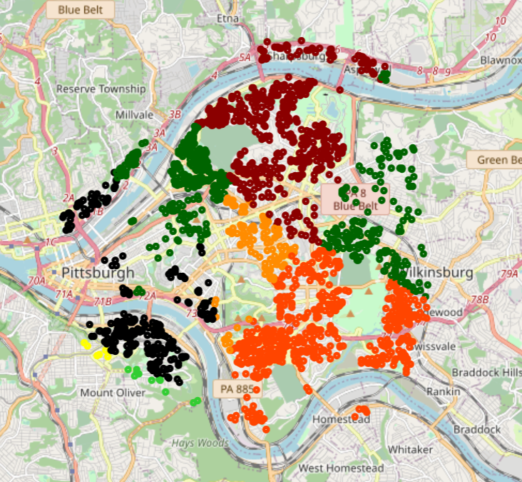
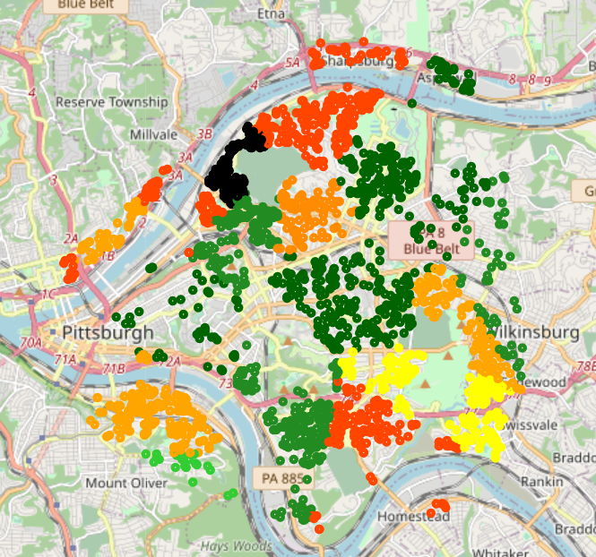
New Features - Local Schools
Score
90-100
80-90
70-80
60-70
50-60
40-50
30-40
20-30
10-20
0-10
High Schools
Elementary/Middle Schools
Notes:
Next we can look at information derived from the NCES -
—----------------------------------------------------
Used the National Center for Education Statistics (NCES) data portal to pull all available data on Pittsburgh Public Schools
For each home, we assigned it two school quality scores: one for the nearest High School, and one for the nearest Elementary/Middle School
Used performance data for schools to calculate a “School Quality” Score:
For High Schools, this was an average of the 4 and 5 year cohort graduation rate, as well as the post-secondary education graduation rate
For Elementary and Middle Schools, this was an average of the percentage of students within the school who were meeting annual growth expectations for ELA/Literature, Mathematics, and Science/Biology

Slide 15

Features
Redfin
Local schools
Crime Data

Slide 16
New Features - Crime
Notes:
Used the Western Pennsylvania Regional Data Center to find crime data in Pittsburgh dating back to 2016.
Every reported incident + exact date/time + exact location
Limited the window of crimes to be considered to 12 months on each side of the sale date of the house - crime trends change over the years and we wanted to make sure we captured an accurate representation of the crime near a house around the time it was sold.

Slide 17
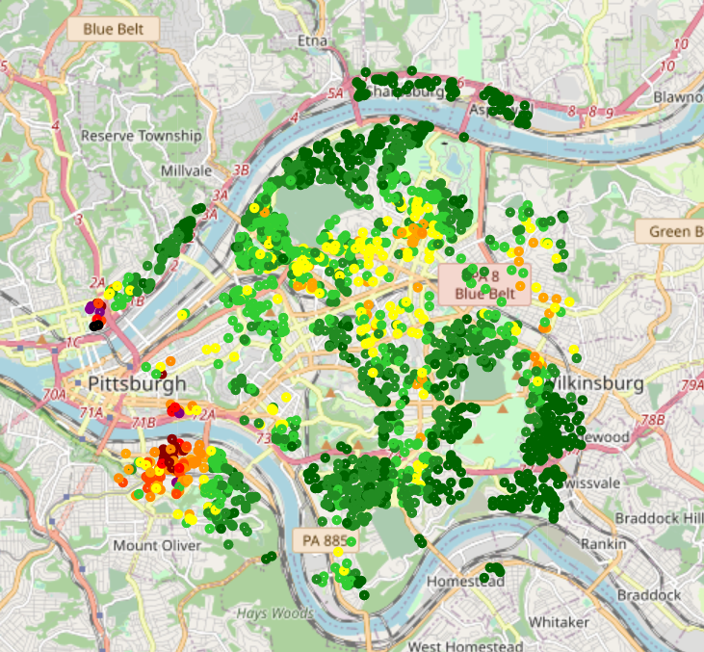
New Features - Crime
Score
0-10
10-20
20-30
30-40
40-50
50-60
60-70
70-80
80-90
90-100
Score = Max(0, 1 - (SQRT(Distance/Max Radius)))
Notes:
Used the Western Pennsylvania Regional Data Center to find crime data in Pittsburgh dating back to 2016.
Every reported incident + exact date/time + exact location
Limited the window of crimes to be considered to 12 months on each side of the sale date of the house - crime trends change over the years and we wanted to make sure we captured an accurate representation of the crime near a house around the time it was sold.
Score = Max(0, 1 - (SQRT(distance/maxRadius)))
Calculated the sum of all “crime scores” for each home, then normalized between 0-100 for all homes
Score function allows us to counterweight crimes up to a certain max radius, with closer proximity crimes having a larger weight

Slide 18

Features
Redfin
Local schools
Crime Data
Census data

Slide 19
New Features - Census Data
American Community Survey
Detailed 5 Year Estimates
Notes:
Our team also incorporated data from the American Community Survey provided by the Census Bureau
This survey has information about the residents that live in a certain geographic area
For our use case we opted to use census tract as the geographic area…
but what is a census tract and what does that look like for pittsburgh?

Slide 20
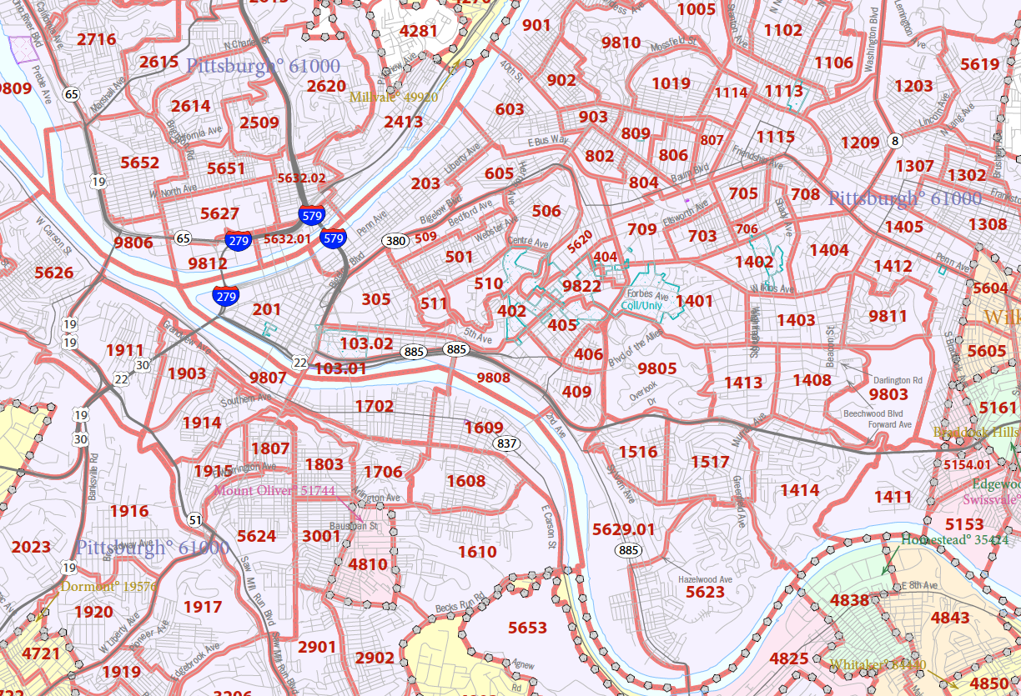
What is a Census Tract?
Source -> https -> //www2.census.gov/geo/maps/DC2020/PL20/st42_pa/censustract_maps/c42003_allegheny/DC20CT_C42003.pdf
Notes:
There are a few different levels that were available to us in terms of granularity
Our team ultimately decided on using a census tract as it somewhat resembles the neighborhoods of pittsburgh
and gave enough population in each block to have a meaningful summary

Slide 21
Example Census Features
B25109_001E
housing_OwnerOccupiedMedianValue
B25111_001E
renting_MedianRentValue
B15012_009E
bachelors_STEM
B19001_017E
income_200KOrMore
B15003_025
Eeducation_DoctorateDegree
……. And more
Notes:
For our model our team sifted through 20,000 variables manually and selected some of what we believe would be leading indicators of home prices
We extracted these features from the Census’ API and appended them to the redfin, schools, and crime dataframes
With that being said,
Some of the variables most likely wouldnt make sense to include in our model like “SEX OF WORKERS BY MEANS OF TRANSPORTATION TO WORK”
While other features like median income would likely be value

Slide 22
Data Preparation

Slide 23
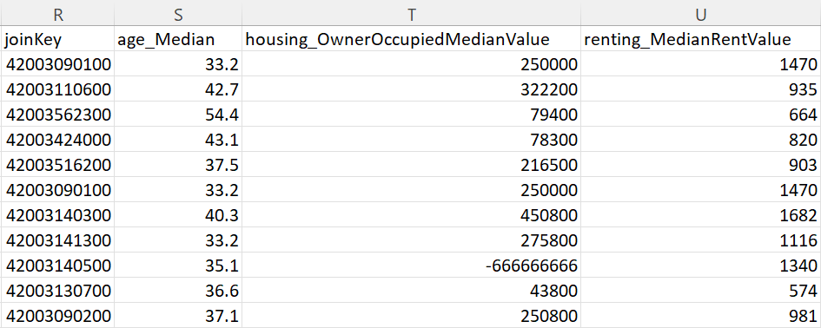
Data Preparation and Feature Engineering
Remove Outliers: Census
-666666666 means that the estimate could not be computed because there were an insufficient number of sample observations
% STEM Bachelor's Degrees =
# of People with STEM Degrees
Total Bachelors Degrees
Notes:
Every data set will require some level of cleaning and ours is not exempt
As seen above, there are certain features that require us to either drop or impute with a reasonable estimate

Slide 24
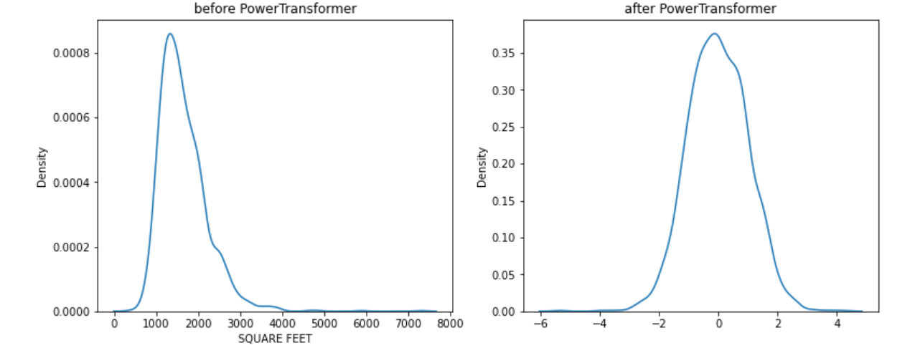
Data Preparation - Transform and Standardize
Notes:
We also used a yeo-johnson transformer, which is similar to BoxCox, to transform our data as well as standardize it
We executed this transformation for all of our variables, some of them had a nice transformation and some of them remained in a similar distribution shape but on a standardized scale

Slide 25
Modeling - ML

Slide 26
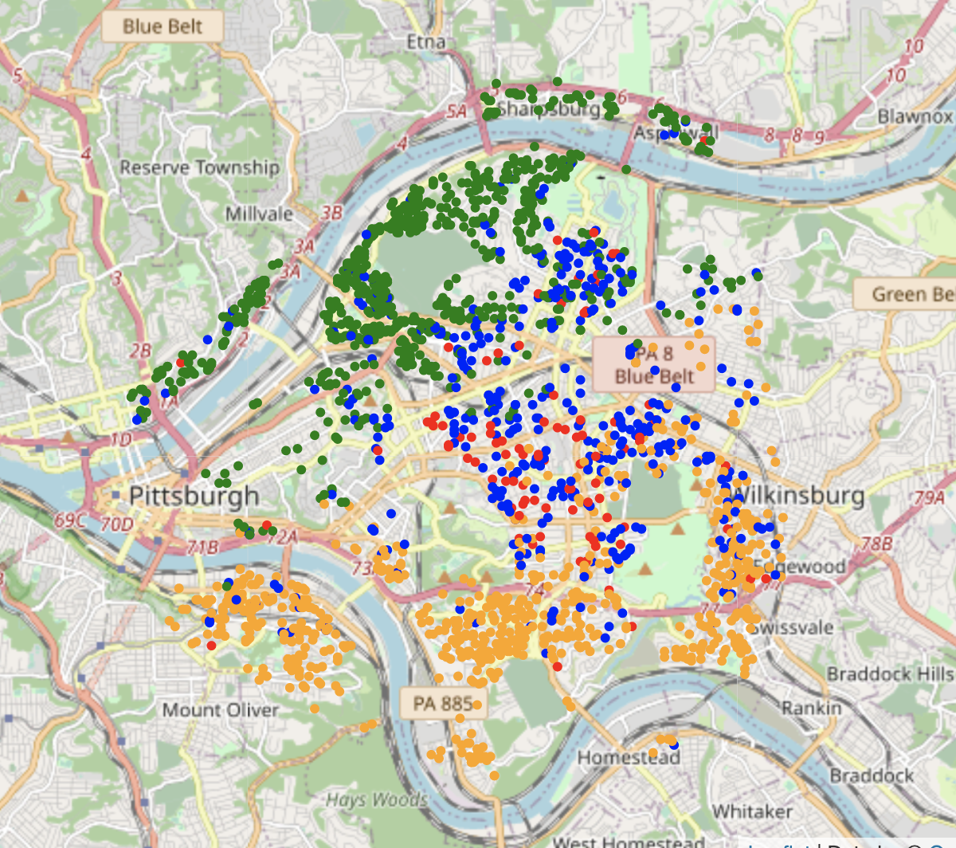
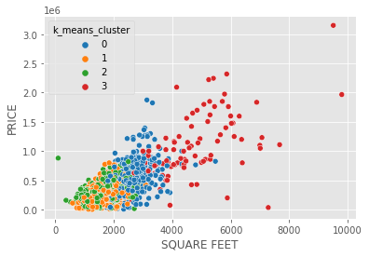
K-Means Experiment– Unsupervised EDA
Added : Latitude and Longitude Vars
Notes:
To test out the latitude and longitude data we passed in spherical coordinates to

Slide 27


Modeling Approach – Supervised
Regression Models with
GridSearchCV
AutoML tool developed by Amazon
Target -> Property Prices
Notes:
After dropping obvious errors and transforming the data we began modeling
We used two frameworks, SK Learn and AutoGluon
We’re all familiar with SK Lean through our coursework so I’ll skip that
For AutoGluon, this is a tool that was developed by Amazon to develop machine learning models
You specify the data you want to train, the label, and the AutoML takes care of the rest

Slide 28
Modeling Approach
Models Evaluated:
Lasso
Ridge
Elastic Net
Kernel Ridge
Bayesian Ridge
Decision Tree
Random Forest
Gradient Boosting
Multilayer Perceptron
Stochastic Gradient Descent
Notes:
We tried numerous SK Learn models to varying degrees of success
From explaininable models like Lasso to more “black-box” style of models like Gradient Boosting
Ultimately we ended up with a champion model of Gradient Boosting Regressor

Slide 29
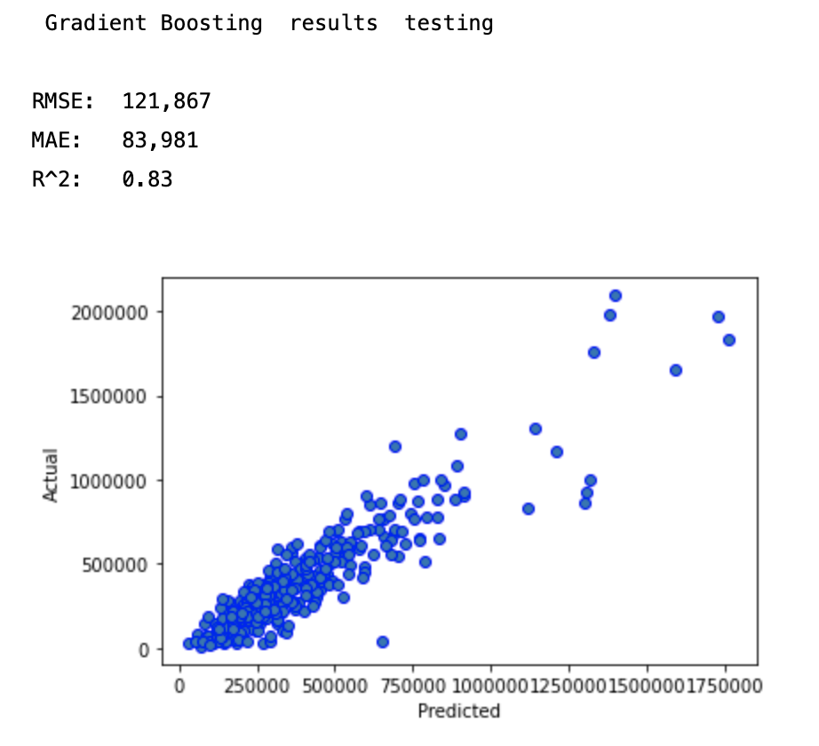
Scikit Learn Champion Model
Gradient Boosting Champion Model
MAE and RMSE
High leverage testing points
Notes:
GB model had an Mean Absolute Error of $83K, which,
for a market like Pittsburgh, leaves a lot to be desired
The model has numerous high leverage points
that are driving our errors upward
Looking at the actuals on the left, we can see the residuals greatly increase between 500K and 750K in terms of the actual sale price
NEXT SLIDE

Slide 30
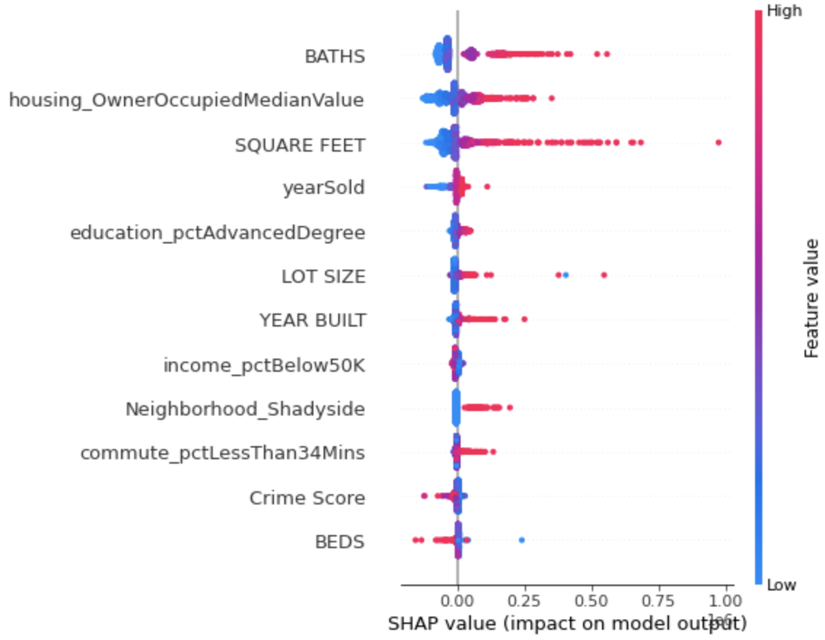
Scikit Learn Champion Model
A
A
BATHS is most important feature
High BEDS -> lowers home price
B
B
Notes:
While gradient boosting does provide us with feature importances,
we also ran a SHAP analysis on the model
SHAP beeswarm tells us that BATHS is the
most important feature and properties with more baths will have increase price
Some things surprised us like homes with high BEDS
end up having an effect of lowering the home price, but this is explained by the high correlation between the variables.
Overall, we can say in conjunction, BEDS and BATHS would have a positive effect on the home price.
<REFER TO TEXT ON SLIDE>

Slide 31
Modeling Approach
Models Evaluated:
XGBoost
CatBoost
Extra Trees
Light GBM
K Neighbors
Random Forest
Neural Net Fast AI
Light GBM Xtreme
Weighted Ensemble
Notes:
This then brings us to our next candidate model which used the AutoGluon framework
AutoGluon allowed our team to try out numerous models with little code
As you can see we trained a variety of regressor models
Weighted ensemble combines the predictions from multiple models, to improve model performance.

Slide 32
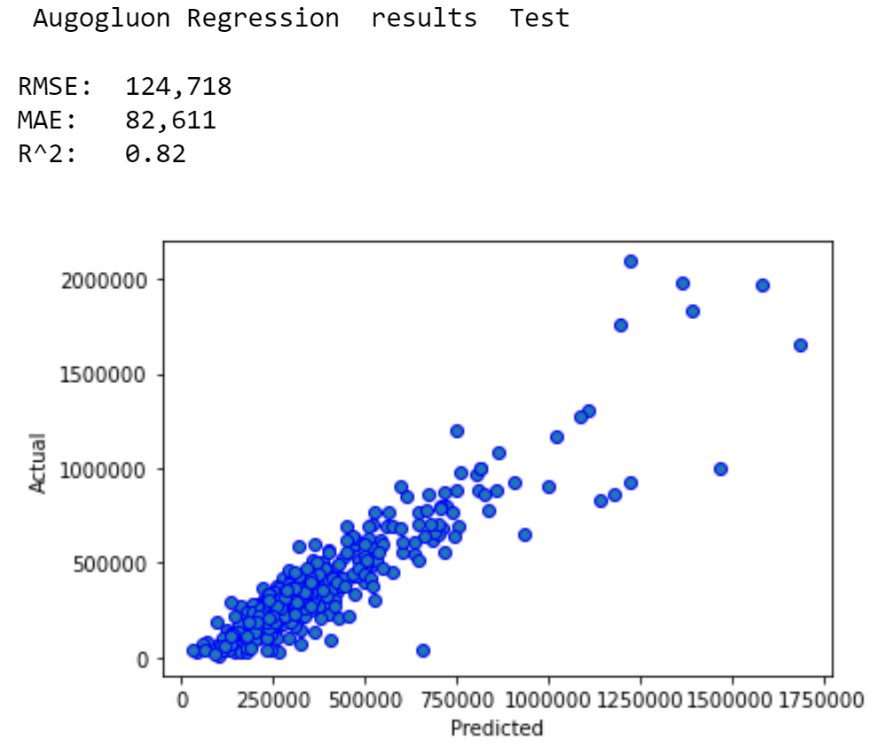
AutoGluon Champion Model (Weighted Ensemble)
Large residuals for properties priced over $500,000
Notes:
Interestingly, we still see this same trend in high leverage points for home prices above approximately $500K

Slide 33
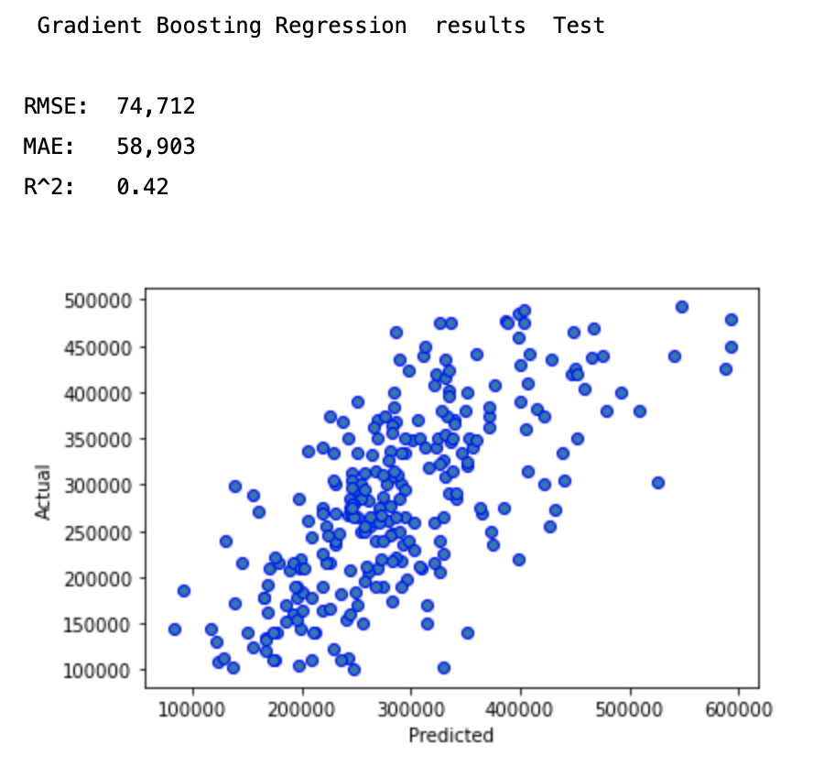
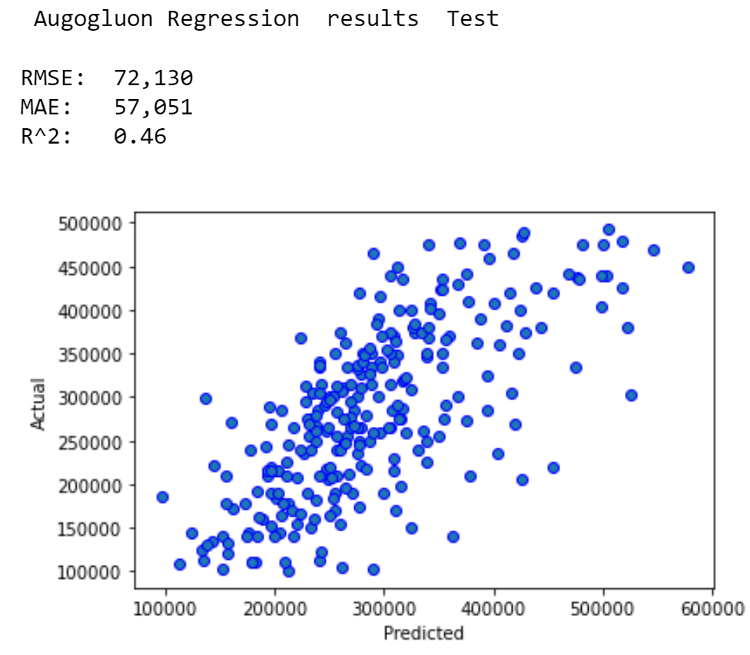
Limiting Results to Homes to $100K - $500K
Notes:
In an effort to provide some usability, we then analyzed the subset of predictions to where the empirical home price was between 100K and 500K
This resulted in a ~26% decrease in MAE and puts our model into the realm of feasible

Slide 34
Results Comparison

Slide 35

Solution Effectiveness
 | Baseline Linear Reg | SK Learn GB Regression | AutoGluon Ensemble
R Squared | 0.74 | 0.83 | 0.82
MAE | $93,381 | $83,981 | $82,611
RMSE | $137,752 | $121,867 | $124,718
Notes:
How effective is your solution?
What would you recommend as next steps?

Slide 36
Next Steps

Slide 37
Next Steps
Modeling
Computer Vision
NLP on Property Descriptions
Business
Expansion to other cities
Property investment opportunities
Notes:
Modeling
Expand off of learning and incorporate computer vision by training and testing on pictures inside and outside of the houses
NLP on descriptions -> “fixer upper” “newly renovated” “bargain”
Business
Expand to different geographies and increase training size
Using model parameters to pinpoint investment opportunities in up and coming areas
That is, we look for prices our model over-predicted relative to the actual price
Embed trend analysis ?!

Slide 38
Lesson Learned
Real World Variability
New Information is helpful
Notes:
Real world data is not often clean -> subject to high-variability and
something we initially went through that we thought would be straightforward
turned out to have a lot of nuance in terms of cleaning data
If we had to do this again we would definitely focus our efforts on improving our dataset
and easing the overall burden of our data preparation process
Modeling is an iterative process, when we didn’t have satisfactory results,
we were able to bring in new information and improve our estimates

Slide 39
References
Redfin - https://www.redfin.com/
Pittsburgh School Data - https://nces.ed.gov/ccd/districtsearch/district_detail.asp?ID2=4219170
Pittsburgh Crime Data - https://data.wprdc.org/dataset/uniform-crime-reporting-data
American Census Survey - https://www.census.gov/programs-surveys/acs
Pittsburgh Census Data - https://api.census.gov/data/

Slide 40
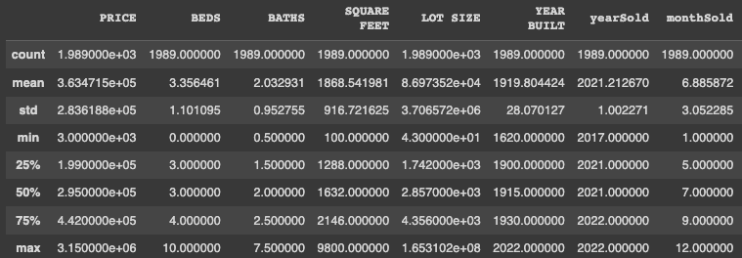
Redfin Description

Slide 41
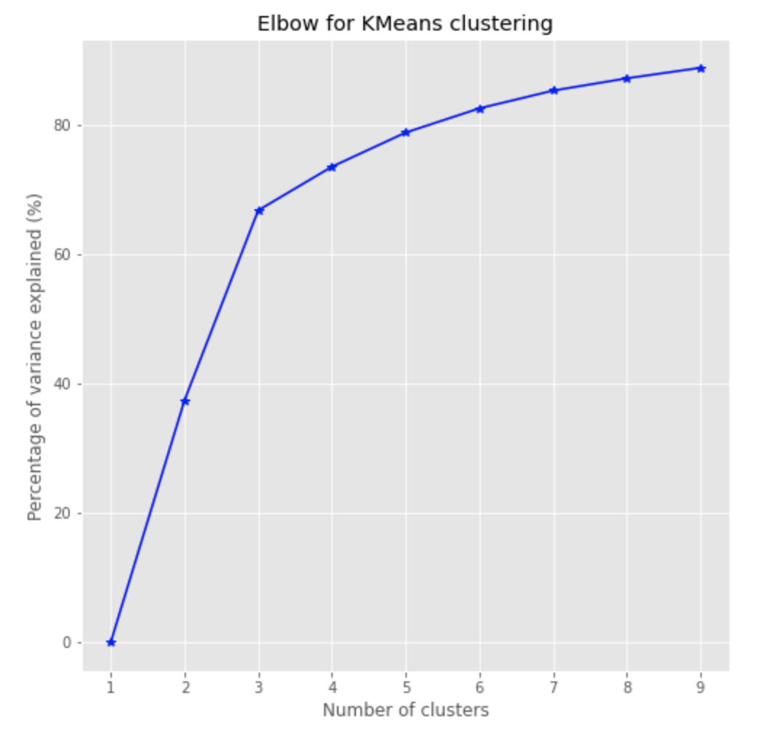
Elbow Plot for K-Means

Slide 42
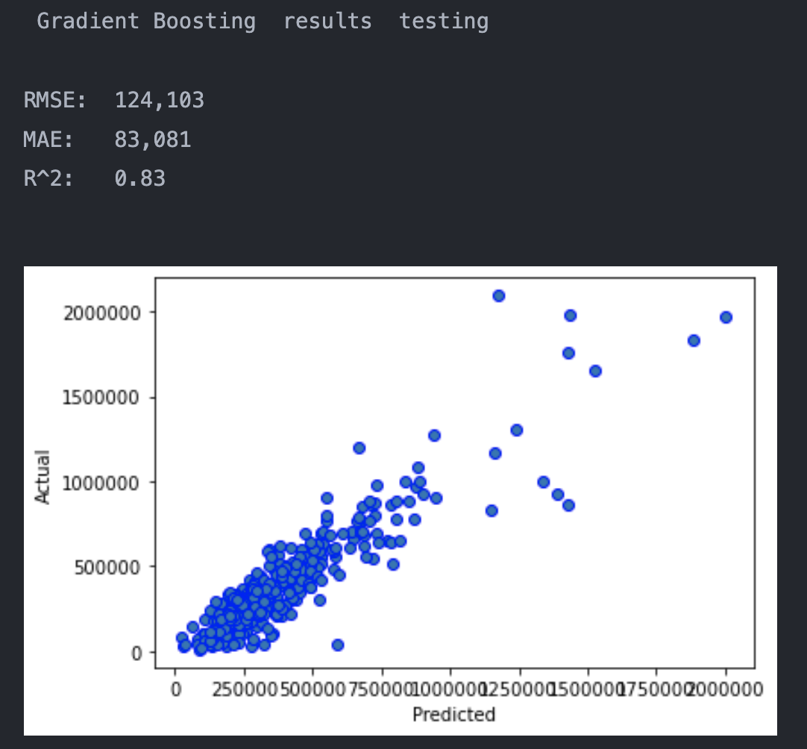
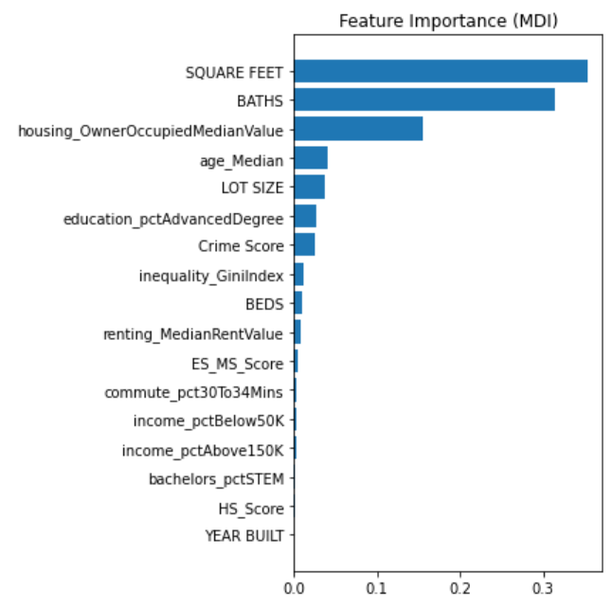
Scikit Learn Champion Model
Gradient Boosting Champion Model
Notes:
GB model had an MAE of 87K, which, for a market like Pittsburgh, leaves a lot to be desired
NEXT SLIDE

Slide 43
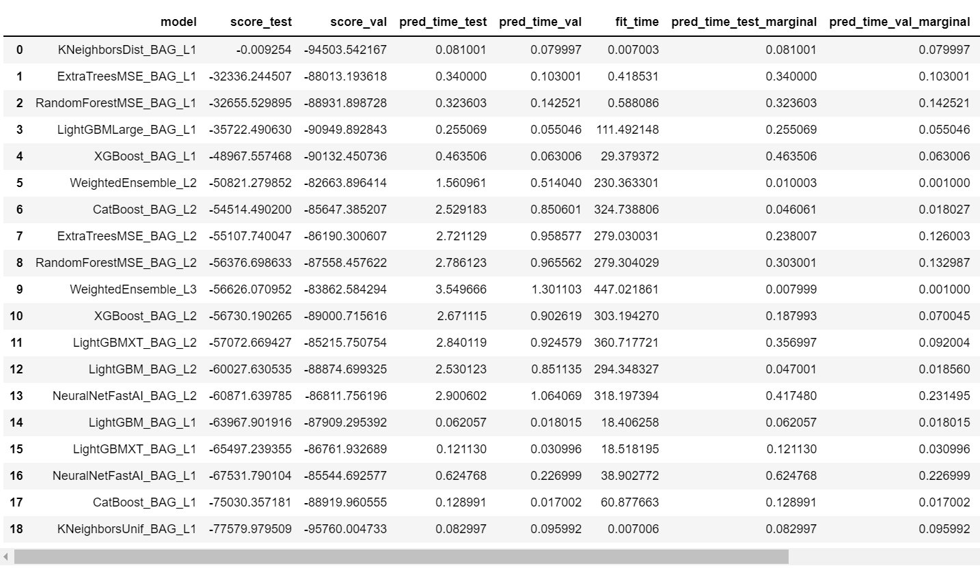
AutoML Model Summary

Slide 44
Variables Selected
B01002_001E -> age_Median
B25109_001E -> housing_OwnerOccupiedMedianValue
B25111_001E -> renting_MedianRentValue
B08134_001E -> commute_Total
B08134_007E -> commute_30to34mins
B15012_001E -> bachelors_Total
B15012_009E -> bachelors_STEM
B15003_001E -> education_Total
B15003_023E -> education_MasterDegree
B15003_024E -> education_ProfessionalDegree
B15003_025E -> education_DoctorateDegree
B19083_001E -> inequality_GiniIndex
B19001_001E -> income_Total
B19001_002E -> income_LessThan10K
B19001_003E -> income_10Kto15K
B19001_004E -> income_15Kto20K
B19001_005E -> income_20Kto25K
B19001_006E -> income_25Kto30K
B19001_007E -> income_30Kto35K
B19001_008E -> income_35Kto40K
B19001_009E -> income_40Kto45K
B19001_010E -> income_45Kto50K
B19001_014E -> income_100Kto125K
B19001_015E -> income_125Kto150K
B19001_016E -> income_150Kto200K
B19001_017E -> income_200KOrMore
Source -> https -> //www2.census.gov/geo/maps/DC2020/PL20/st42_pa/censustract_maps/c42003_allegheny/DC20CT_C42003.pdf
Notes:
There are a few different levels that were available to us in terms of granularity
Our team ultimately decided on using a census tract as it somewhat resembles the neighborhoods of pittsburgh and gave enough population in each block to have a meaningful summary
We could get more granular but each block has somewhere between a few hundred to over 1000 people in it

